Slide 1

Response time of Alkali Antimonides
John Smedley
Brookhaven National Laboratory

Slide 2
Overview
The Three-Step Model and Response Time
  Metallic Photocathodes
  Semiconductor Photocathodes
    Positive Electron Affinity (Alkali Antimonide)
    Negative Electron Affinity (Cs: GaAs)
Diamond Electron Amplifier
Modern Theory and Applications of Photocathodes
W.E. Spicer & A. Herrera-Gómez
SAC-PUB-6306 (1993)

Slide 3
Three Step Model of Photoemission - Metals
1) Excitation of e⁻ in metal
Reflection
Absorption of light
Energy distribution of excited e⁻
2) Transit to the Surface
e⁻-e⁻ scattering
mfp ~50 angstroms
Direction of travel
3) Escape surface
Overcome Workfunction
Reduction of Φ due to applied
  field (Schottky Effect)
Integrate product of probabilities over
all electron energies capable of
escape to obtain Quantum Efficiency
Vacuum level
Φ
hν
Φ’
Empty States
Φ
Energy
Filled States
Light
Medium
Vacuum
M. Cardona and L. Ley: Photoemission in Solids 1, (Springer-Verlag, 1978)

Slide 4
“Prompt”
Metals have very low quantum efficiency, but they are prompt emitters, with fs response times for near-threshold photons:
To escape, an electron must be excited with a momentum vector directed toward the surface, as it must have
The “escape” length verses electron-electron scattering is typically under 10 nm in the near threshold case. Assuming a typical hot electron velocity of 10⁶ m/s, the escape time is 10 fs.
(this is why the LCLS has a Cu photocathode)
  W.F. Krolikowski and W.E. Spicer, Phys. Rev. 185, 882 (1969)
  D. H. Dowell et al., Phys. Rev. ST Accel. Beams 9, 063502 (2006)
  T. Srinivasan-Rao et al., PAC97, 2790

Slide 5
Three Step Model - Semiconductors
1) Excitation of e⁻
  Reflection, Transmission, Interference
  Energy distribution of excited e⁻
2) Transit to the Surface
  e⁻-phonon scattering
  mfp ~100 angstroms
  many events possible
  e⁻-e⁻ scattering (if hν>2E_{g})
  Spicer’s Magic Window
  Random Walk
  Monte Carlo
  Response Time (sub-ps)
3) Escape surface
Overcome Electron Affinity
Empty States
E_{a}
hν
Φ
E_{g}
No States
Energy
Filled States
Light
Medium
Vacuum

Slide 6
A.R.H.F. Ettema and R.A. de Groot, Phys. Rev. B 66, 115102 (2002)

Slide 7
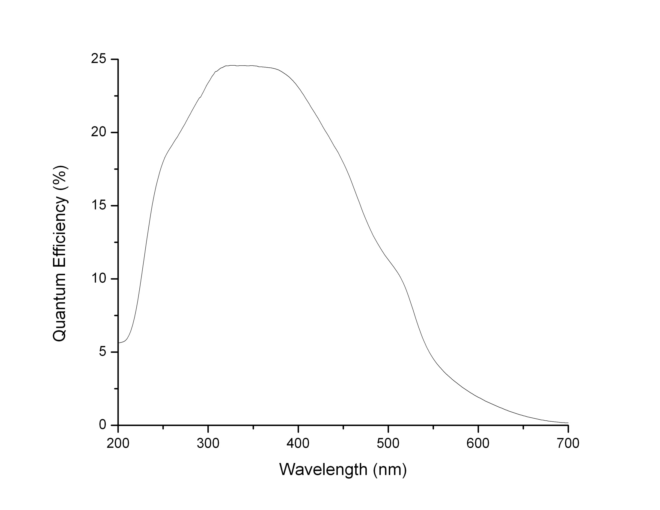
Spectral Response – Bi-alkali
In “magic window”
Unproductive absorption
Onset of e-e
scattering

Slide 8
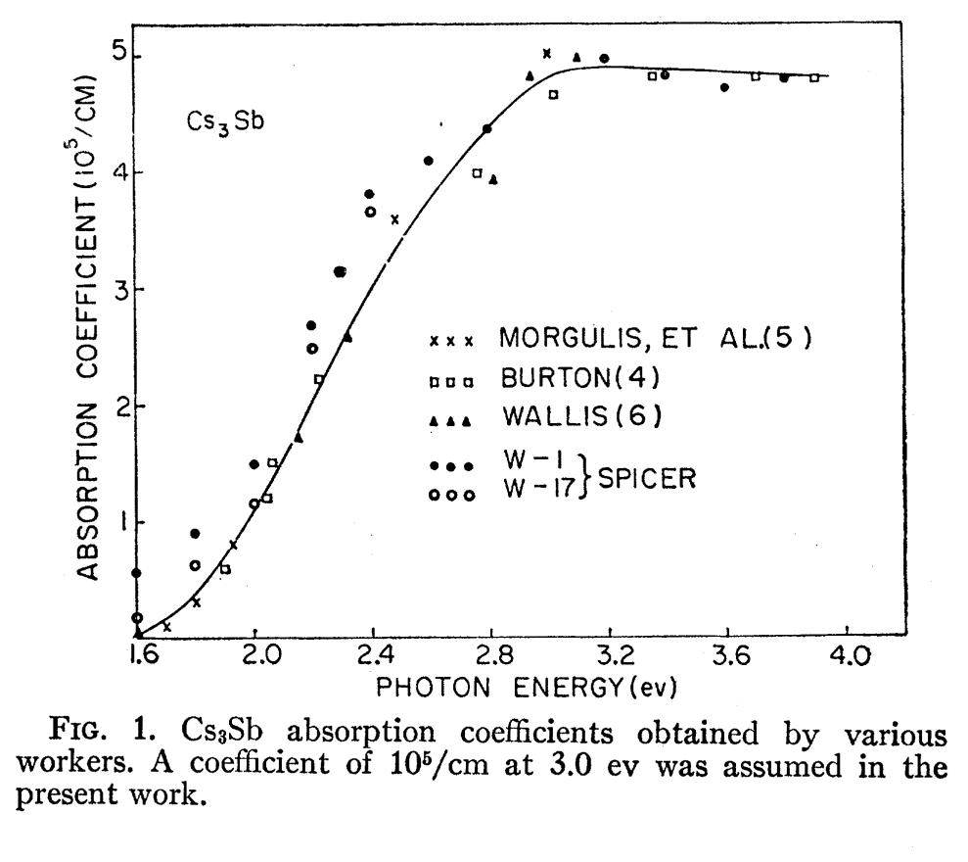
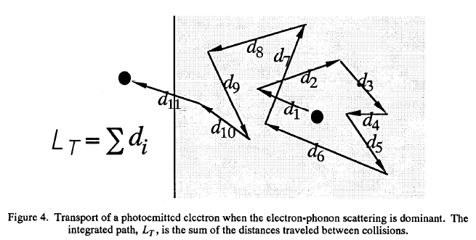
Cs₃Sb (Alkali Antimonides)
Work function 2.05 eV, E_{g}= 1.6 eV
Electron-phonon scattering length
~5 nm
Loss per collision ~0.1 eV
Photon absorption depth
~20-100 nm
Thus for 1 eV above threshold, total path length can be ~500 nm (pessimistic, as many electrons will escape before 100 collisions)
This yields a response time of
~0.6 ps
Alkali Antimonide cathodes have been used in RF guns to produce electron bunches of 10’s of ps without difficulty
D. H. Dowell et al., Appl. Phys. Lett., 63, 2035 (1993)
W.E. Spicer, Phys. Rev., 112, 114 (1958)

Slide 9

Diamond Amplifier Concept
(first strike solution?)
Thin Metal
Layer
Diamond
(NEA)
MCP
(10-30 nm)
Transparent
Secondary
Conductor
Primary
Electrons
Electron
Photon
Photocathode
3-10 kV

Slide 10
Diamond Amplifier Setup
Hydrogenated surface
Phosphor Screen
Diamond
Focusing Channel
Pt metal coating
CCD camera
0- to 10-keV Electron beam
Anode with holes
A
H.V. pulse generator

Slide 11
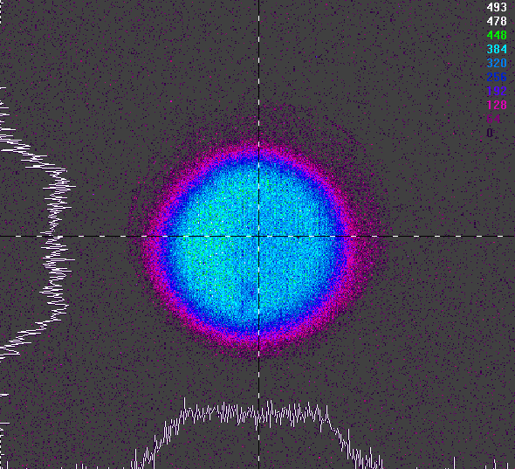
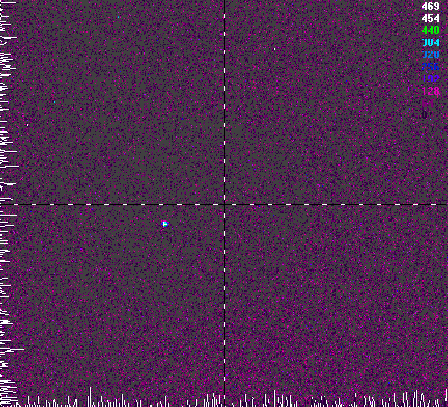
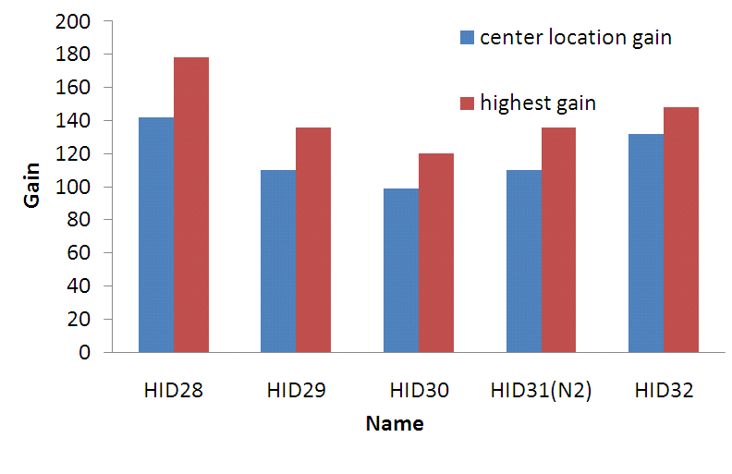
Diamond Amplifier Results
Demonstrated emission and gain of >100 for 7 keV primaries
Would need large area polycrystalline diamonds, probably still too expensive
Maybe NEA GaAs amplifier?
With focusing
X. Chang et al., Phys. Rev. Lett. 105, 164801 (2010).

Slide 12
Closing Thoughts
Thanks!
D. Dowell (SLAC/LCLS), Henry & Klaus for the invitation; V. Radeka, I. Ben-Zvi, and my colleagues at BNL
While not strictly “prompt” in the manner of metals, the alkali atimonides have sub-ps response time
Could be improved to some extent (at the cost of QE) by making the cathode very thin
Electron stimulated desorption/Ion back-bombardment?

Slide 13
Three Step Model – NEA Semiconductors
Excitation of e⁻
  Reflection, Transmission, Interference
2) Transit to the Surface
  e⁻-lattice scattering
  thermalization to CBM
  diffusion length can be 1µm
  recombination
  Random Walk
  Monte Carlo
  Response Time (10-100 ps)
3) Escape surface
Empty States
hν
E_{a}
No States
E_{g}
Energy
Filled States
Laser
Medium
Vacuum

Slide 14
Step 1 – Absorption and Excitation
Fraction of light absorbed:
I_{ab}/I = (1-R)
Probability of absorption and electron excitation:
Medium thick enough to absorb all transmitted light
Only energy conservation invoked, conservation of k vector is not an important selection rule

Slide 15
Step 2 – Probability of reaching the surface w/o e⁻-e⁻ scattering
Energy loss dominated by e-e scattering
Only unscattered electrons can escape

Slide 16
EDC and QE
At this point, we have N(E,hν) - the Energy Distribution Curve of the emitted electrons
Yield:
Quantum efficiency:

Slide 17
Step 3 - Escape Probability
Criteria for escape:
Requires electron trajectory to fall within a cone defined by angle:
Fraction of electrons of energy E falling with the cone is given by:
For small values of E-E_{T}, this is the dominant factor in determining the emission. For these cases:
This gives:
θ

Slide 18
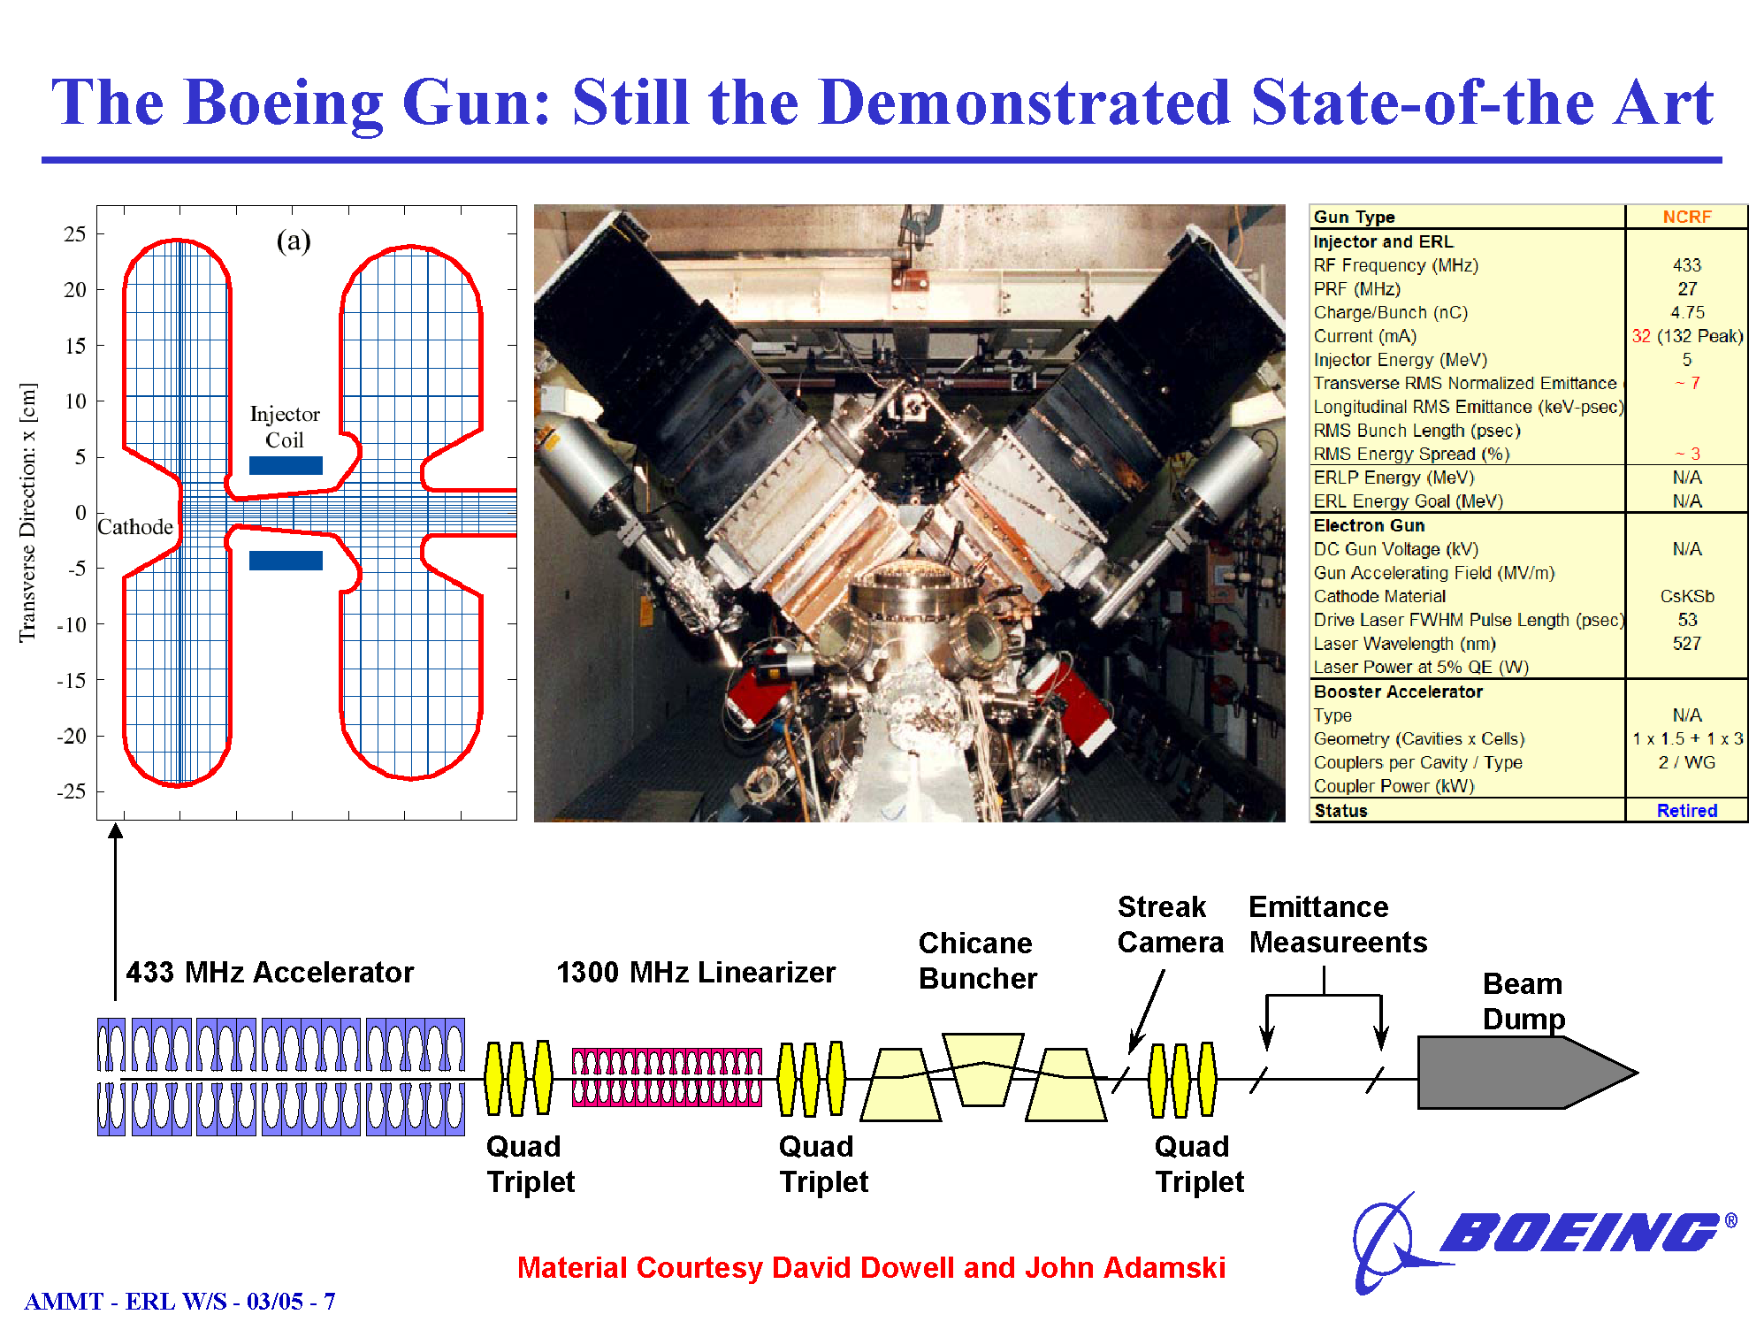
Cathode Parameters
K₂CsSb
5%-12% QE @ 527nm
Peak Current 45-132A
Average Current 35 mA
(140 mA @ 25% DC)
Lifetime 1-10 hrs
Gun Parameters
433 MHz
26 MV/m peak field
0.6 MW RF Power
D. H. Dowell et al., Appl. Phys. Lett., 63, 2035 (1993)

Slide 19
Laser Propagation and Interference
Laser energy in media
Calculate the amplitude of the Poynting vector in each media
Not exponential decay
543 nm
Vacuum
K₂CsSb
200nm
Copper

Slide 22
Spatial Variation of QE for a Thin K₂CsSb Cathode

Slide 23
Electron Transport in Diamond
Energy
Empty States
E_{a}
E_{g}
Surface Trap
Bulk Trap
Filled States
Primary e⁻ penetrate < 1μm into diamond
Lose energy via e⁻-e⁻ scattering
Excite e⁻ into conduction band
Some e- and holes will diffuse to metal (probability based on drift velocity)
Some e⁻ are trapped
Most drift to vacuum side (hopefully)
Trapped e⁻ modify field in diamond
Hydrogen termination lowers electron affinity (achieve NEA)
Some e⁻ trapped at surface
Most will be emitted (hopefully)
Secondary e⁻ lose energy via e⁻-e⁻ and e⁻-phonon scattering
Eventually, e⁻ reaches the bottom of the conduction band
Holes drift toward metal layer, e⁻ into diamond

Slide 24
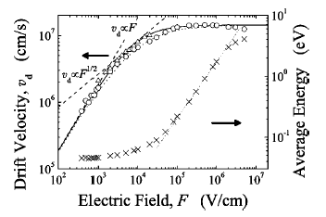
Challenges
  Watanabe et al, J. of Applied Physics, 95 4866 (2004)
Electrons must escape diamond
  Diamond must <30 μm for 700 MHz RF
  Negative Electron Affinity (NEA) surface for emission
  Field in the diamond is a critical parameter
    Field should be high enough for v_{e} to saturate
    Field should be low enough to minimize e⁻ energy
    Modeling suggests 3 MV/m – good for SRF injector
Diamond must not accumulate charge
  Material must have a minimum of bulk/surface traps
  Stimulated detrapping
  Metal layer required to neutralize holes
    Minimize energy loss in metal (low Z, low ρ)
Practical aspects
  Electron stimulated desorption
  Heat load and thermal stresses (1100K to 77K)
  Effect of ion/electron back-bombardment on H-terminated surface

Slide 25
Diamond Measurements in Transmission Mode
Diamond is metallized on both sides
Contact is made by annular pressure
Electrodes are used to bias diamond and measure current
Outer electrodes biased to prevent photoemission
x-rays/e⁻

Slide 26
Gain in Transmission Mode

Slide 27
Diamond X-ray Response

Slide 28
Diamond X-ray Response
NSLS U3C/X8A
Pt edge
Ti edge
C edge

Slide 29
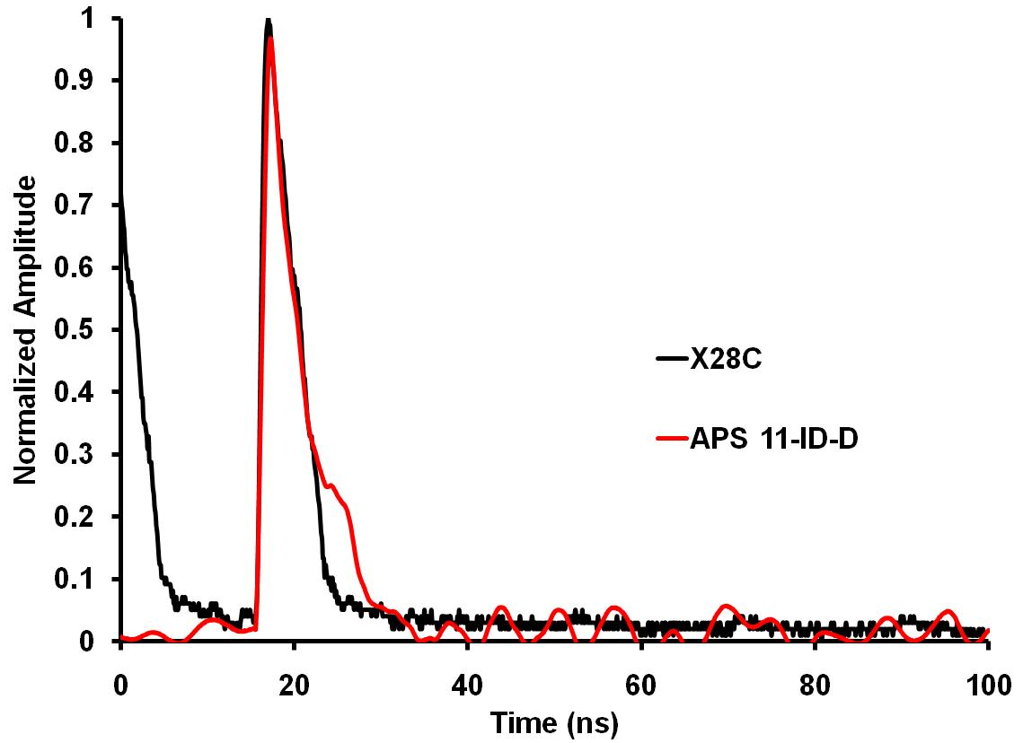
Diamond Timing – Hard X-rays

Slide 30
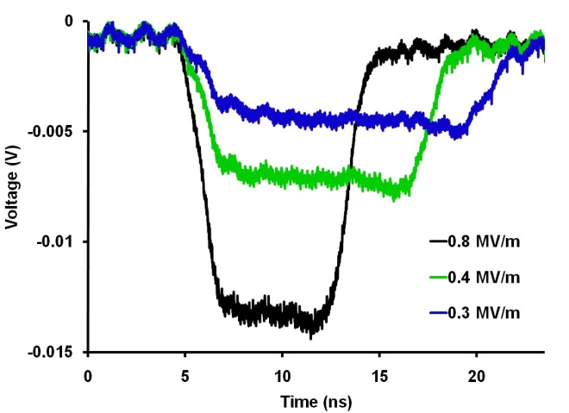
Diamond Timing – Soft X-rays

